Slide 1
The Smaller the Easier
Introduction to Divide and Conquer (D&C)
Dustin Xu

Slide 2
Find the Number
A Warmup Task for You

Slide 3

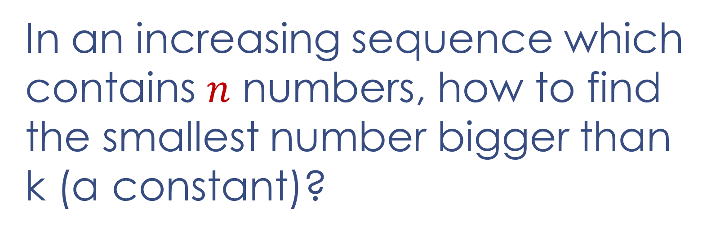
Find the Number
In an increasing sequence which contains $n$ numbers, how to find the smallest number bigger than k (a constant)?
an $O(\log{n})$time algorithm

Slide 4
Divide and Conquer (D&C)
Divide the problem into a number of subproblems that are smaller instances of the same problem.
Conquer the subproblems by solving them recursively. If the subproblem sizes are small enough, however, just solve the subproblems in a straightforward manner.
Combine the solutions to the subproblems into the solution for the original problem.

Slide 5
Fast Exponentiation
An Easy Task for You

Slide 6
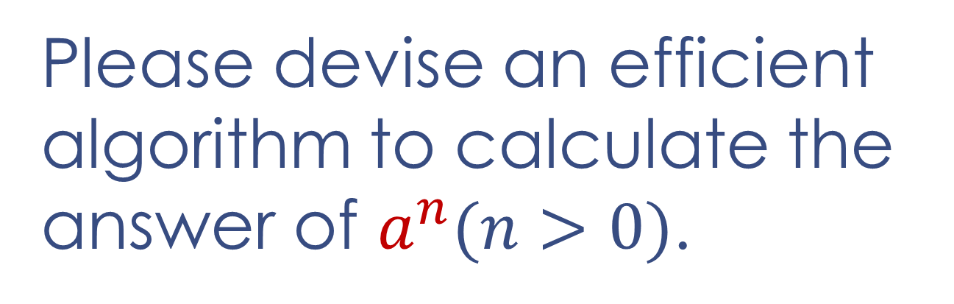
Fast Exponentiation
Please devise an efficient algorithm to calculate the answer of $a^{n}(n>0)$.

Slide 7


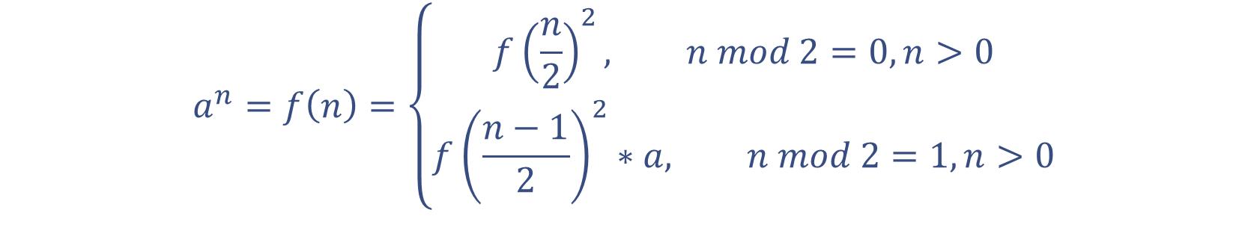
Fast Exponentiation
an $O(\log{n})$time algorithm
$$a^{n}=f\left(n\right)=\left\{\begin{aligned}f{\left(\frac{n}{2}\right)}^{2}, n mod 2=0, n>0 \\ &f{\left(\frac{n−1}{2}\right)}^{2}∗a, n mod 2=1, n>0\end{aligned}\right.$$
$$f\left(0\right)=1$$
$$f\left(17\right)$$
𝑓(17)
$$f\left(4\right)$$
𝑓(4)
$$f\left(8\right)$$
𝑓(8)
$$f\left(2\right)$$
𝑓(2)
$$f\left(1\right)$$
𝑓(1)
$$f\left(0\right)$$
𝑓(0)

Slide 8
Combine Sequences
An Interesting Task for You

Slide 9
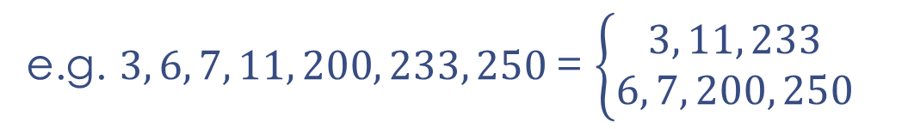
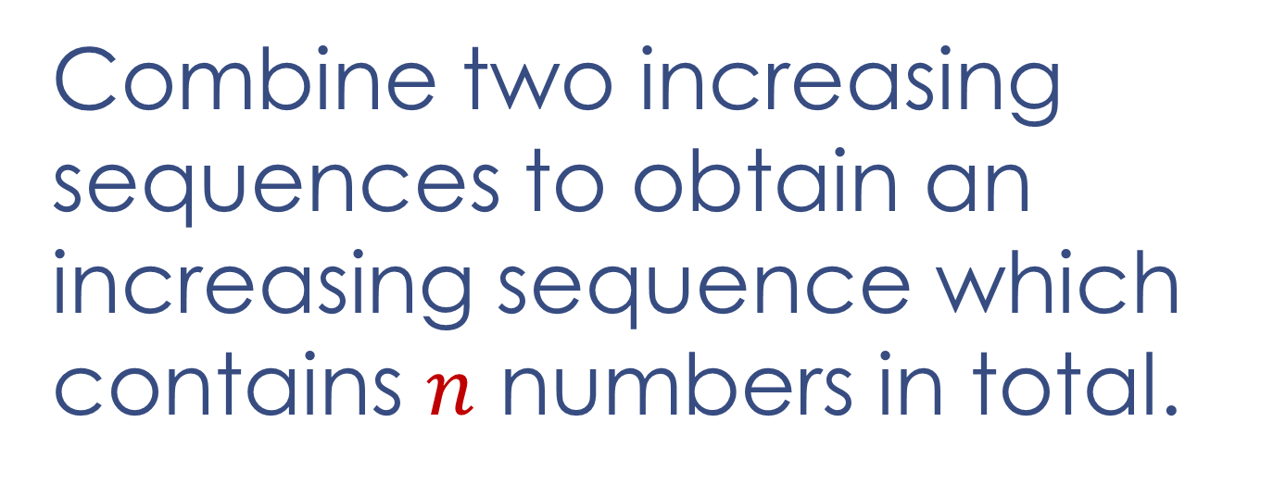
Combine Sequences
Combine two increasing sequences to obtain an increasing sequence which contains $n$ numbers in total.
e.g. $3, 6, 7, 11, 200, 233, 250$= $\left\{\begin{aligned}3, 11, 233 \\ 6, 7, 200, 250\end{aligned}\right.$

Slide 10
Combine Sequences
Compare the first number of two sequences and always take out the smaller one to add to the tail of the final sequence.

Slide 11

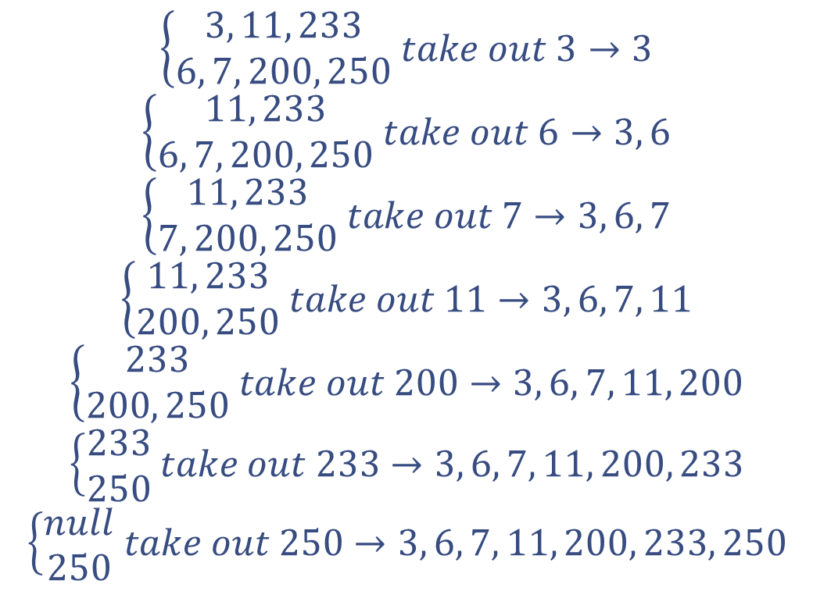
Combine Sequences
$$\left\{\begin{aligned}3, 11, 233 \\ 6, 7, 200, 250\end{aligned} take out 3→3\right.$$
$$\left\{\begin{aligned}11, 233 \\ 6, 7, 200, 250\end{aligned} take out 6→3, 6\right.$$
$$\left\{\begin{aligned}11, 233 \\ 7, 200, 250\end{aligned} take out 7→3, 6, 7\right.$$
$$\left\{\begin{aligned}11, 233 \\ 200, 250\end{aligned} take out 11→3, 6, 7, 11\right.$$
$$\left\{\begin{aligned}233 \\ 200, 250\end{aligned} take out 200→3, 6, 7, 11, 200\right.$$
$$\left\{\begin{aligned}233 \\ 250\end{aligned} take out 233→3, 6, 7, 11, 200, 233\right.$$
$$\left\{\begin{aligned}null \\ 250\end{aligned} take out 250→3, 6, 7, 11, 200, 233, 250\right.$$
An $O(n)$ time algorithm

Slide 12
How to Sort
A More Interesting Task for You

Slide 13
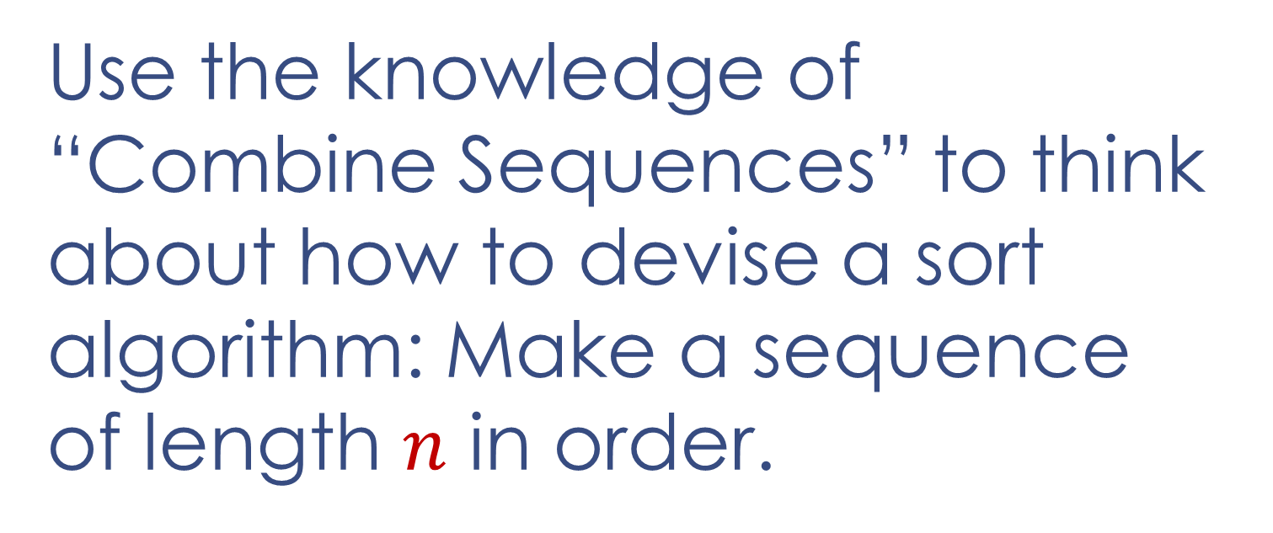
How to Sort
Use the knowledge of “Combine Sequences” to think about how to devise a sort algorithm: Make a sequence of length $n$ in order.
e.g. $200, 6, 250, 7, 11, 3, 233→3, 6, 7, 11, 200, 233, 250$

Slide 14





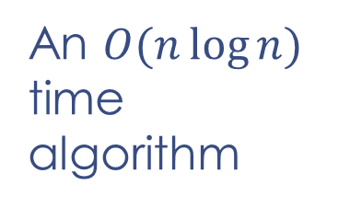








How to Sort
Merge Sort
e.g. $200, 6, 250, 7, 11, 3, 233→3, 6, 7, 11, 200, 233, 250$
An $O(n\log{n})$ time algorithm
$$200, 6, 250, 7, 11, 3, 233$$
$$200, 6, 250, 7$$
$$11, 3, 233$$
$$200, 6$$
$$250, 7$$
$$11$$
$$3, 233$$
$$200$$
$$6$$
$$250$$
$$7$$
Divide
Conquer
Combine
$$3$$
$$233$$

Slide 15
Count Inversions
A Further Task for You

Slide 16
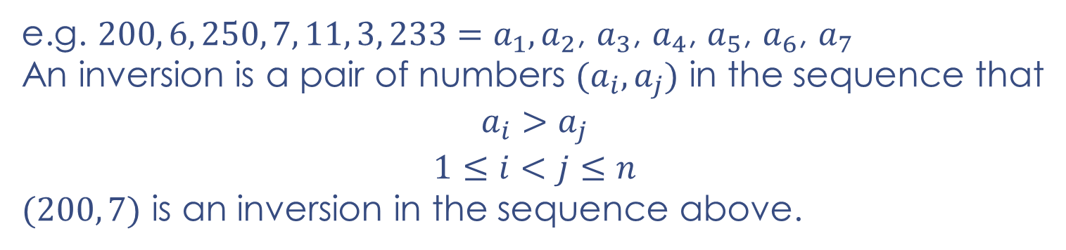

Count Inversions
Count the number of inversions in a sequence of length $n$.
e.g. $200, 6, 250, 7, 11, 3, 233=a_{1},a_{2}\text{, }a_{3}\text{, }a_{4}\text{, }a_{5}\text{, }a_{6}\text{, }a_{7}$
An inversion is a pair of numbers $(a_{i},a_{j})$ in the sequence that
$$a_{i}>a_{j}$$
$$1≤i<j≤n$$
$(200, 7)$ is an inversion in the sequence above.

Slide 17
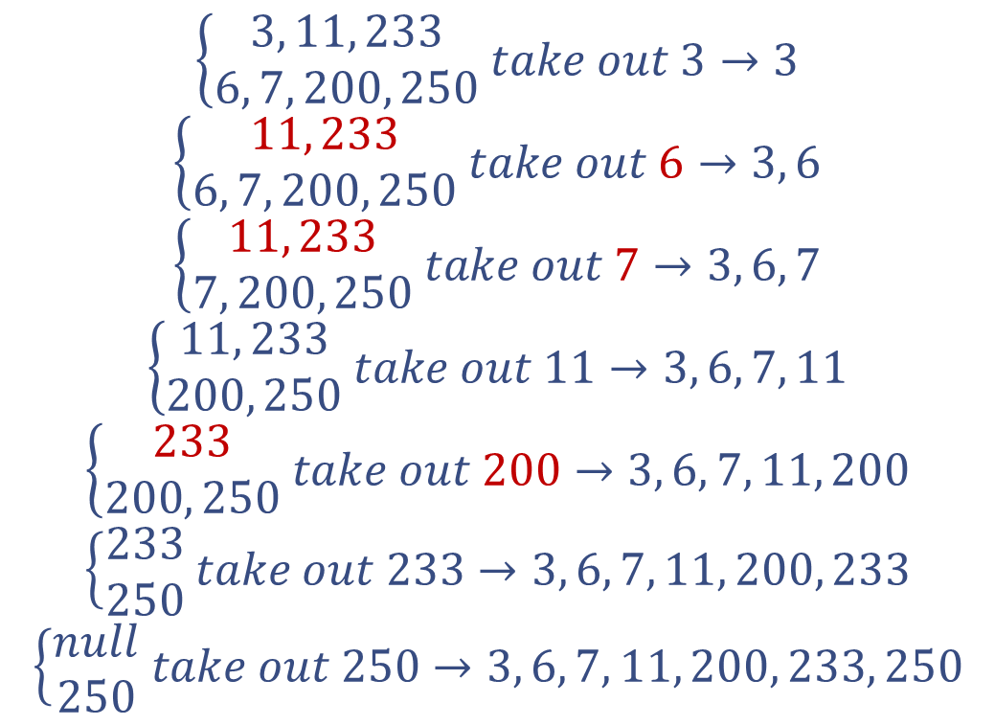
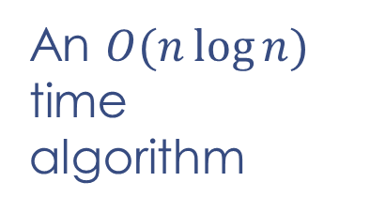

Count Inversions
$$3, 11, 233 | 6, 7, 200, 250$$
Inversions
$$\left\{\begin{aligned}3, 11, 233 \\ 6, 7, 200, 250\end{aligned} take out 3→3\right.$$
$$\left\{\begin{aligned}11, 233 \\ 6, 7, 200, 250\end{aligned} take out 6→3, 6\right.$$
$$\left\{\begin{aligned}11, 233 \\ 7, 200, 250\end{aligned} take out 7→3, 6, 7\right.$$
$$\left\{\begin{aligned}11, 233 \\ 200, 250\end{aligned} take out 11→3, 6, 7, 11\right.$$
$$\left\{\begin{aligned}233 \\ 200, 250\end{aligned} take out 200→3, 6, 7, 11, 200\right.$$
$$\left\{\begin{aligned}233 \\ 250\end{aligned} take out 233→3, 6, 7, 11, 200, 233\right.$$
$$\left\{\begin{aligned}null \\ 250\end{aligned} take out 250→3, 6, 7, 11, 200, 233, 250\right.$$
+2
+2
An $O(n\log{n})$ time algorithm
+1
Divide
Conquer
Combine

Slide 18
Thank you!

